Slide 1

DIABETES PREDICTION USING MACHINE LEARNING TECHNIQUES Final year project Review-2 Batch – (2019-2023) Group Members : Abhay Kumar, Sungjemkaba Reg_no : 2019105194, 2019105219 07 Nov-2022
Department of Computer Science and Engineering
National Institute of Technology Nagaland

Slide 2
Contents
Glimpse of previous review
Proposed model
Flow diagram
Diabetes dataset
Data pre processing
Correlation

Slide 3
Glimpse of previous review
Diabetes is the fastest growing chronic disease in the world , according to world health organization data 537 million people suffering from diabetes and this data is increasing day by day.
Diabetes prediction model may be used in the medical field.
Going through the literature review on diabetes prediction using machine learning techniques , it has been found that using data pre-processing and balancing the accuracy may be increased.
Our objective is to develop a machine learning model for diabetes prediction.

Slide 4
Proposed model
Developing our own machine learning model with lesser running time.
Increasing the efficiency of the model.

Slide 5
Flow diagram
Normal data
PRE PROCESS DATA
PROCESSED
DATA
Classification algorithm such as SVM (support vector machine)
Performance evaluation
DATASET
Oversampled data
undersampled
data
Replacing missing values with mean
Min-max scaler
Result
Comparative analysis
Accuracy and f1 score
Diagram representing the flow of the model.

Slide 6
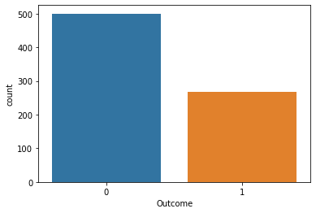
Diabetes dataset
Total no of hypothesis in PIMA diabetes dataset is 768 , out of which 278 is predicting it to be 1(yes) rest 0(no), so the dataset is imbalance.
Not diabetic
Diabetic
Graph representing the diabetes dataset.

Slide 7
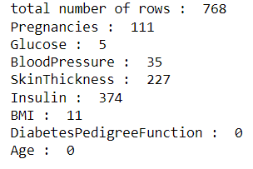
Data pre-processing
Out of 768 hypothesis column of some attribute contain 0 value.
we have replaced that 0 value with mean of particular column.
No of attribute having value as 0.

Slide 8
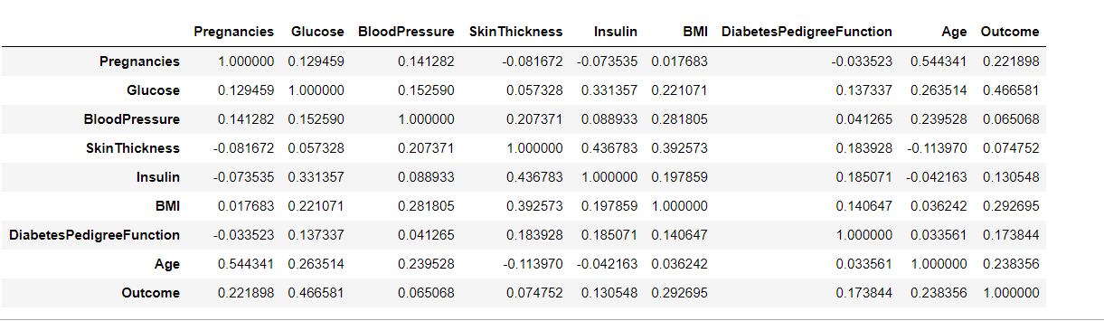
Correlation
The below fig shows the corelation between the different attribute present in the dataset.
On the basis of that we will decide which attribute has the higher effect on the output data.
Here we find out that Glucose concentration has the highest effect on the output where as blood pressure has the lowest effect.

Slide 9
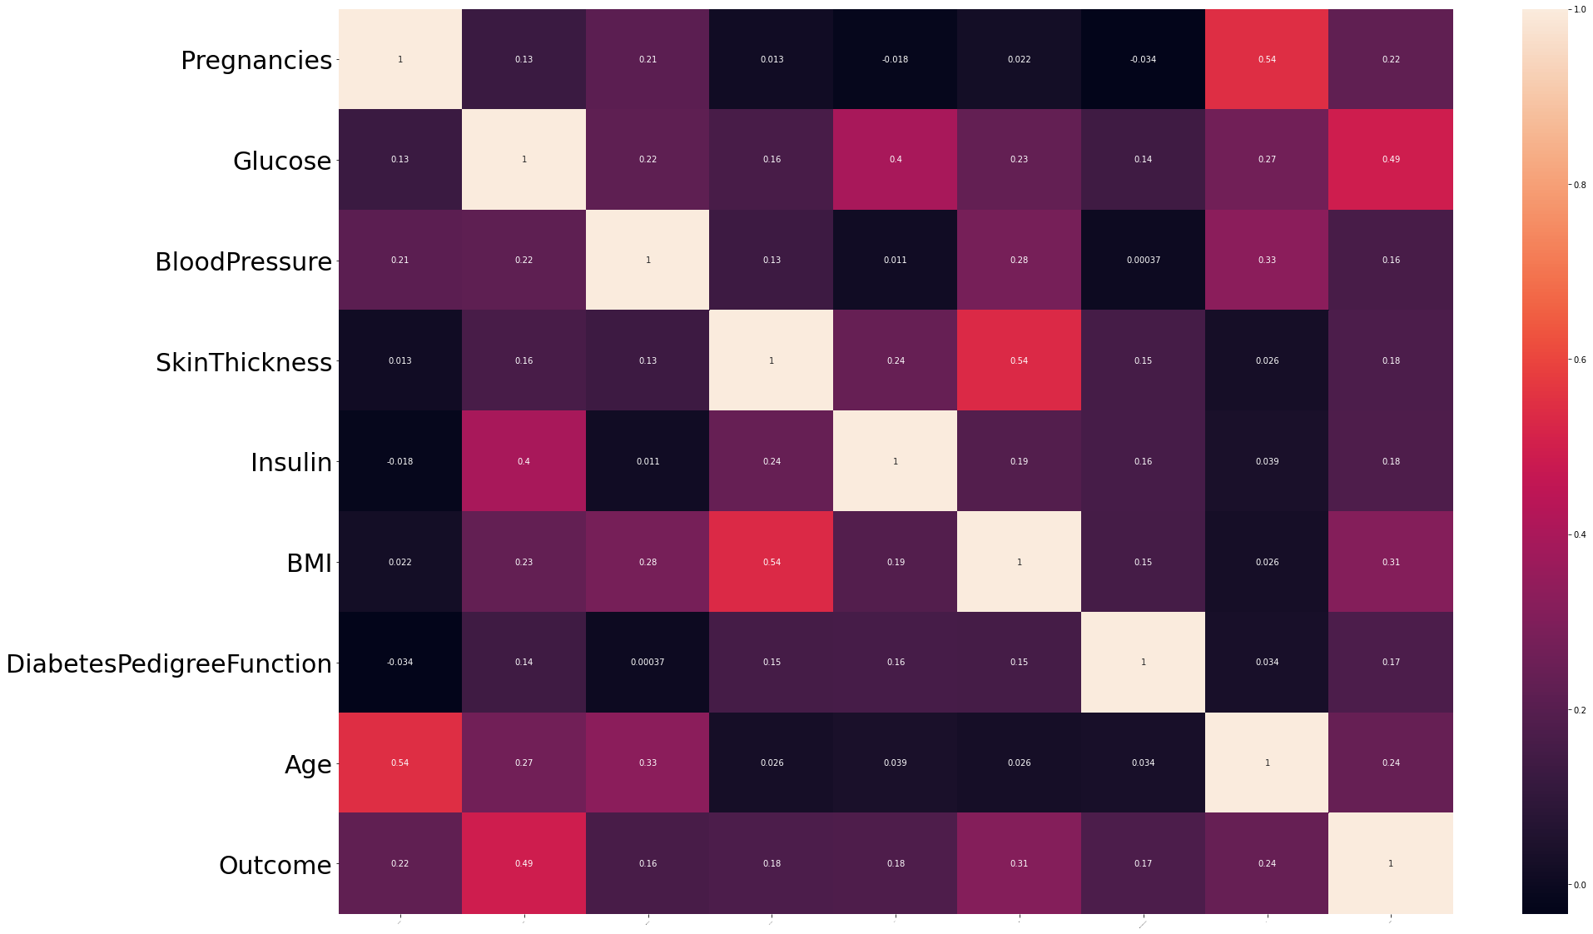
Correlation
Correlation between different attribute and class level value.

Slide 10
Balancing the dataset
We will balance the dataset using oversampling ,under sampling.
In oversampling we have only 278 samples of 1 class level value , so I have randomly select the dataset and make it 500 now the dataset is balanced.
In under sampling we have only 278 samples of 1 class level value so I have selected only 278 samples of class level 0 value in order to balance the dataset.

Slide 11
Feature extraction
Support Vector Machine (SVM) is a relatively simple Supervised Machine Learning Algorithm used for classification / regression.

Slide 12
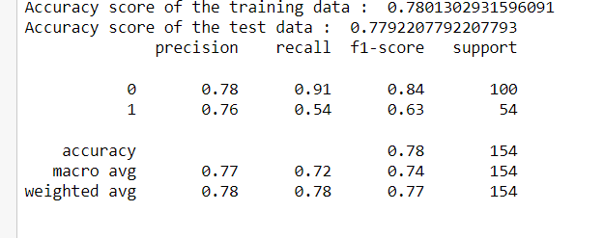
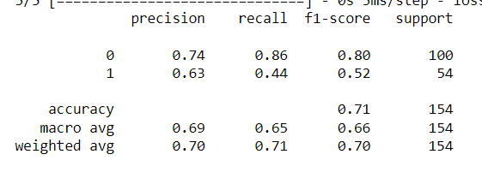
Accuracy analysis on normal data
SVM
ANN

Slide 13
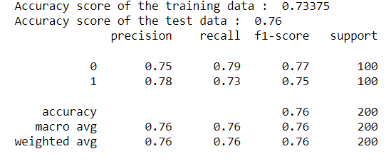
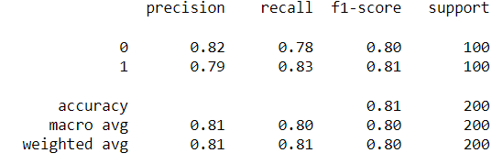
Accuracy analysis on oversampled data
SVM
ANN

Slide 14
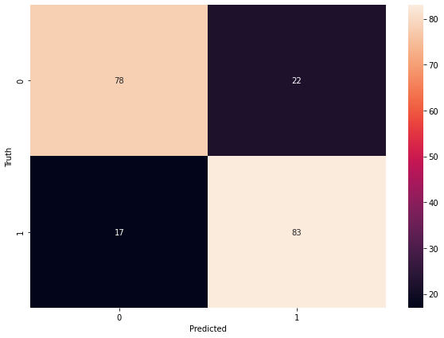
Confusion matrix
We have got an accuracy of 80.5 percent .

